Slide 1
FUSION PROJECT Panel and Module simulation
By
J.MEGALA

Slide 2
Main OBJECTIVE
The main objective is to meet a standardized software
That can replicate the original fire safety devices and modules and continuously provides the input to the main panel.
Those inputs are used for testing, monitoring and diagnosis purposes.

Slide 3
DESIGN OF THE SYSTEM

Slide 4
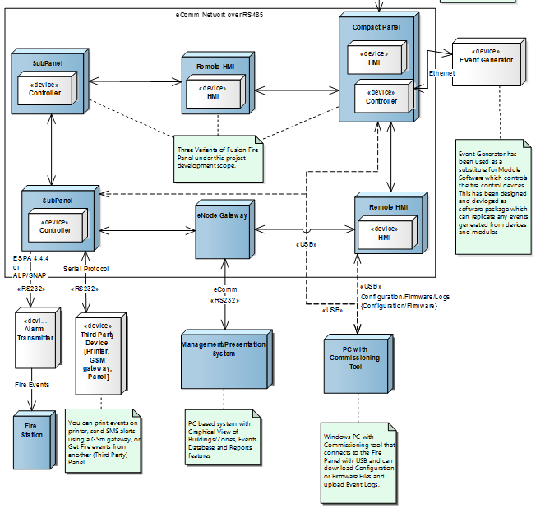

Slide 5
Technology used
Qt
Qt is a cross-platform framework, that is usually used as a graphical toolkit, although it is also very helpful in creating CLI applications. Qt uses standard C++ with extensions including signals and slots that simplify handling of events, and this helps in development of both GUI and server applications

Slide 6
PROBLEM STATEMENT
To meet a standardized software that can replicate the original fire safety devices and modules and continuously provides the input to the main panel for testing , monitoring and diagnosis purposes.

Slide 7
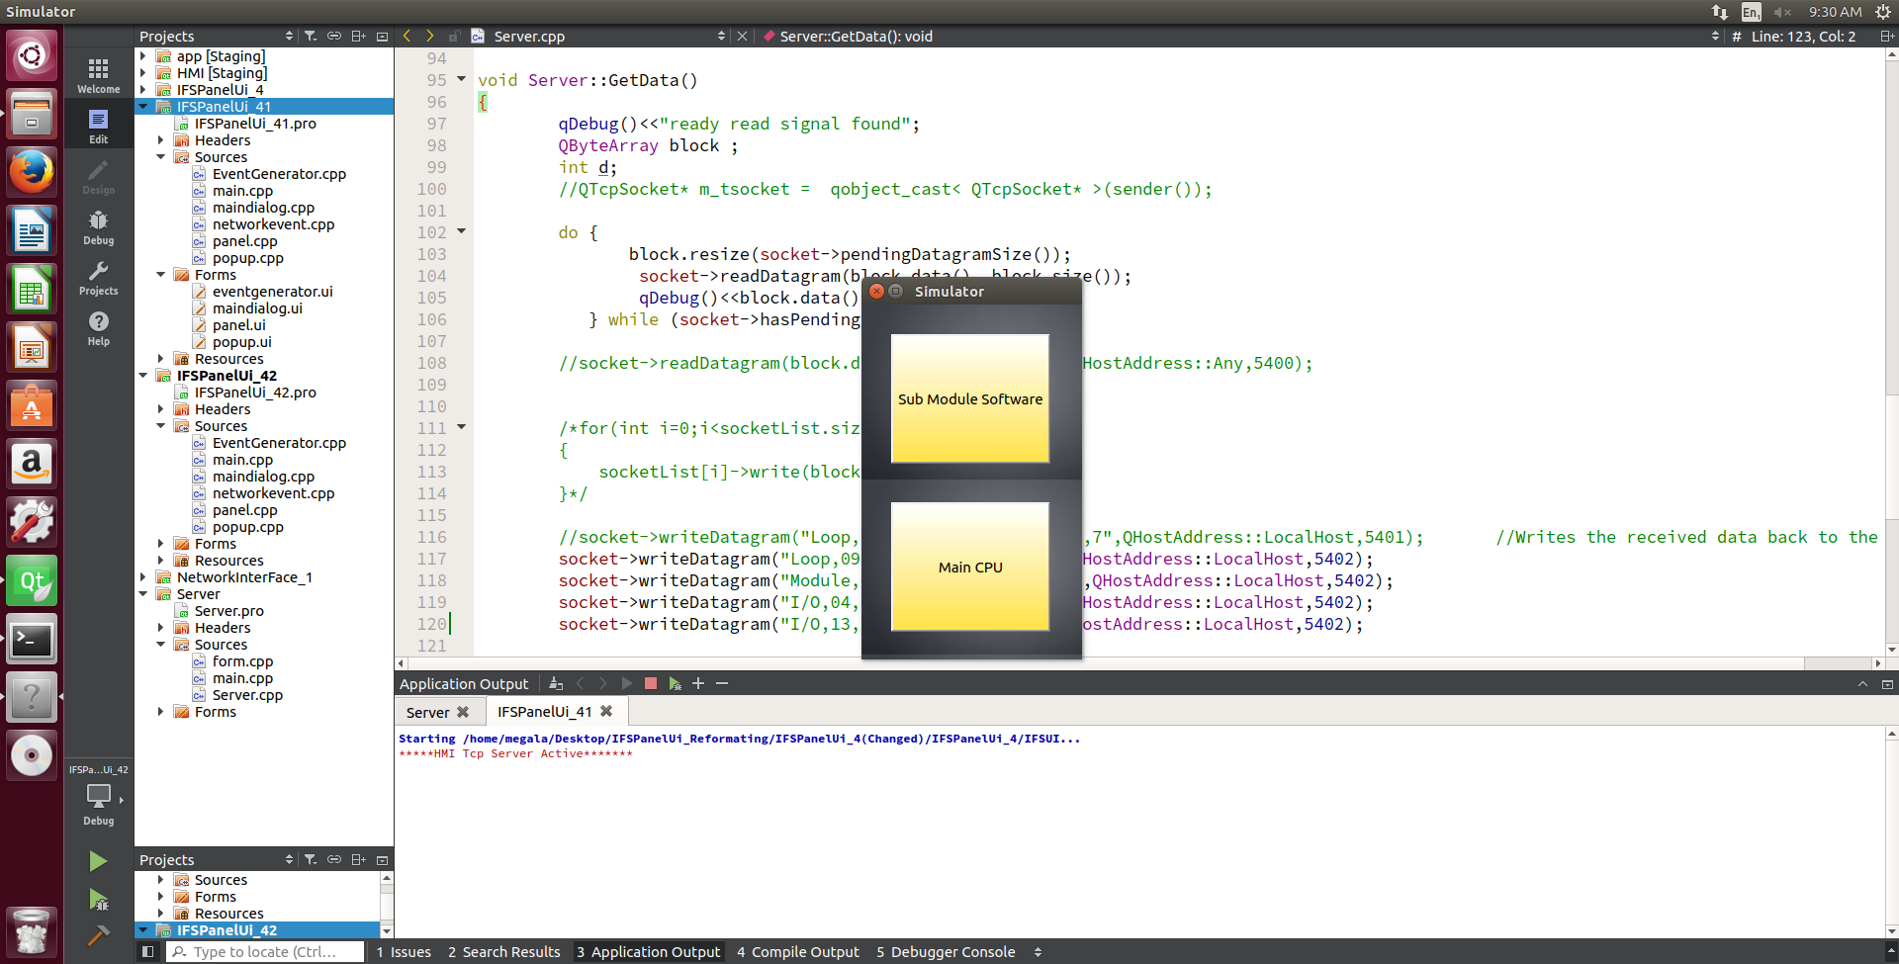

Slide 8
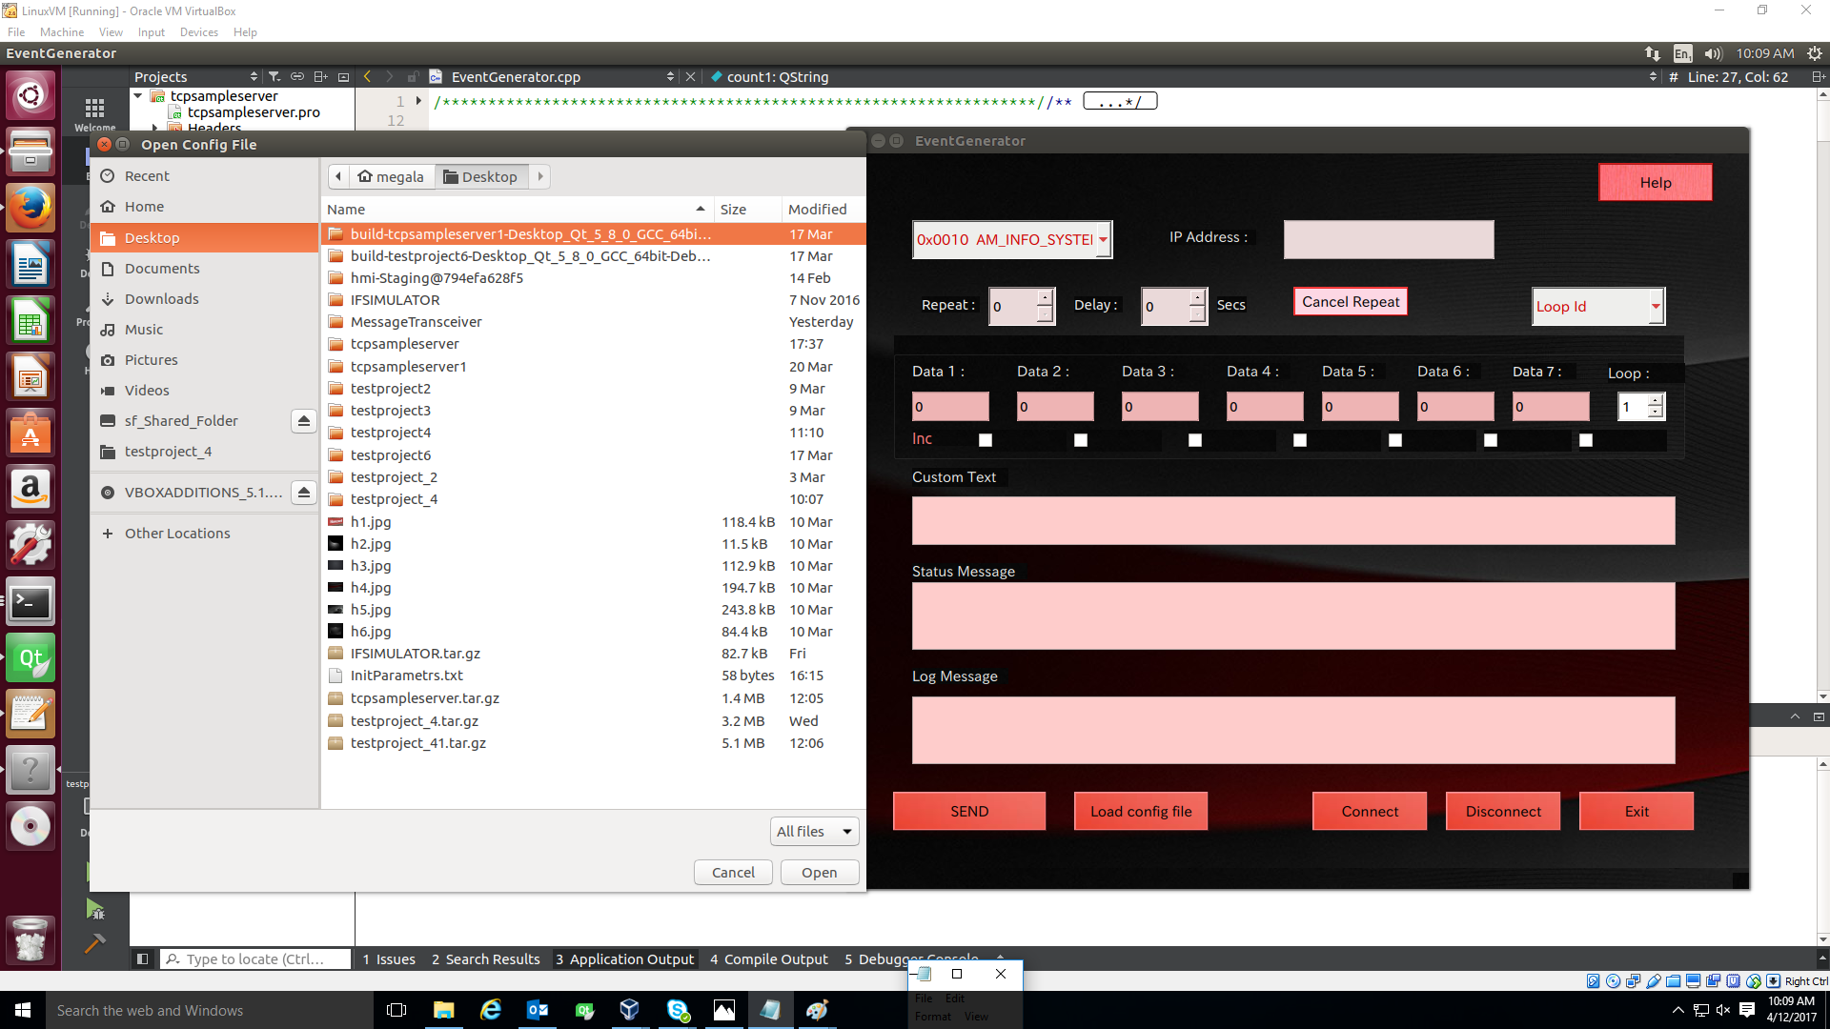

Slide 9
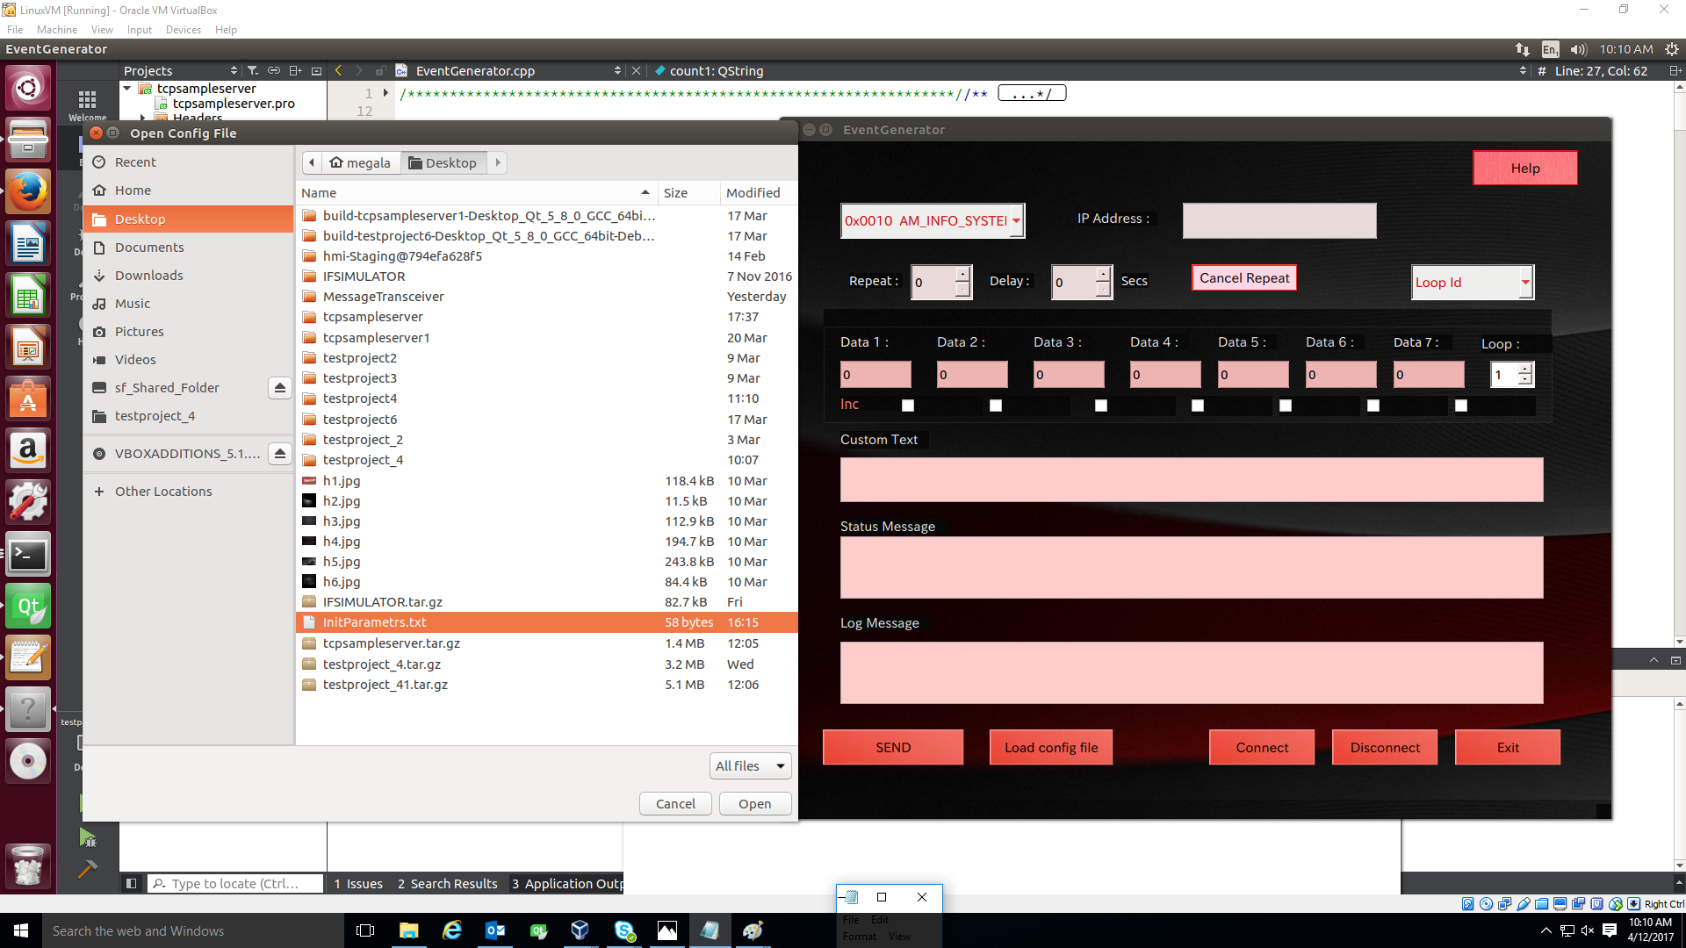

Slide 10
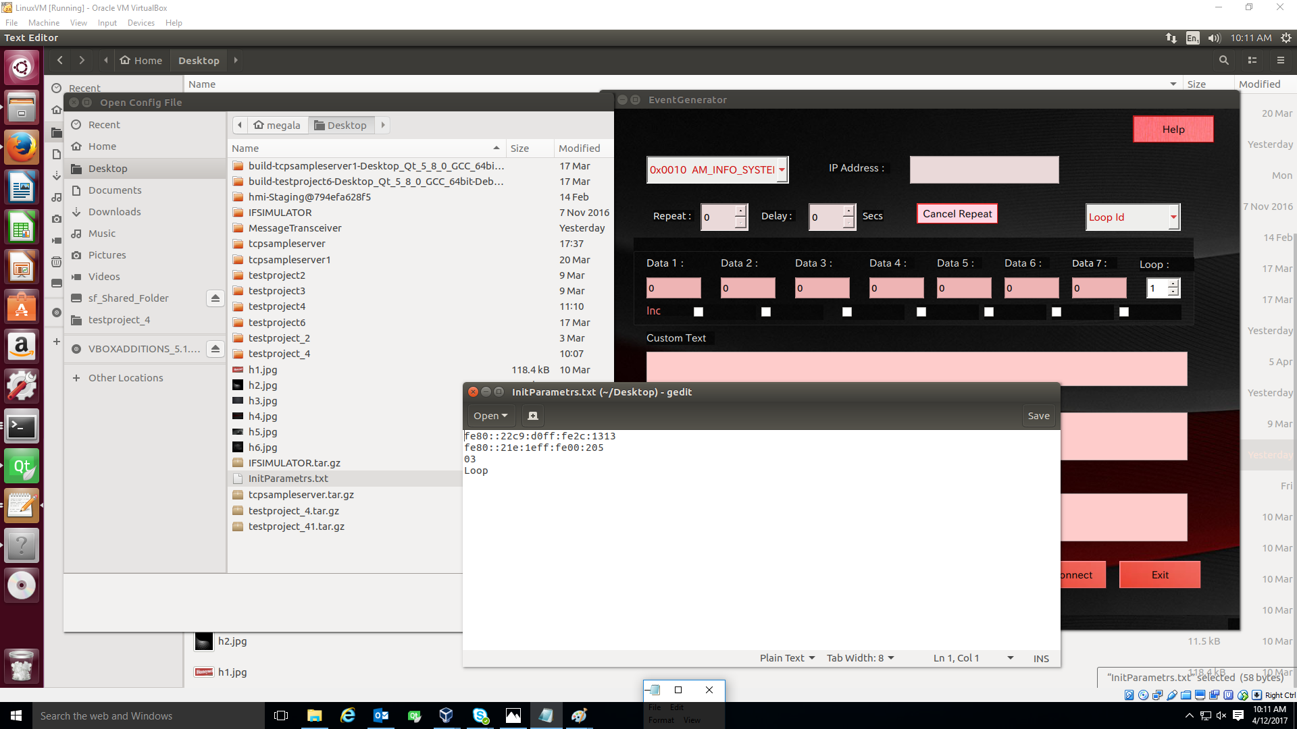

Slide 11
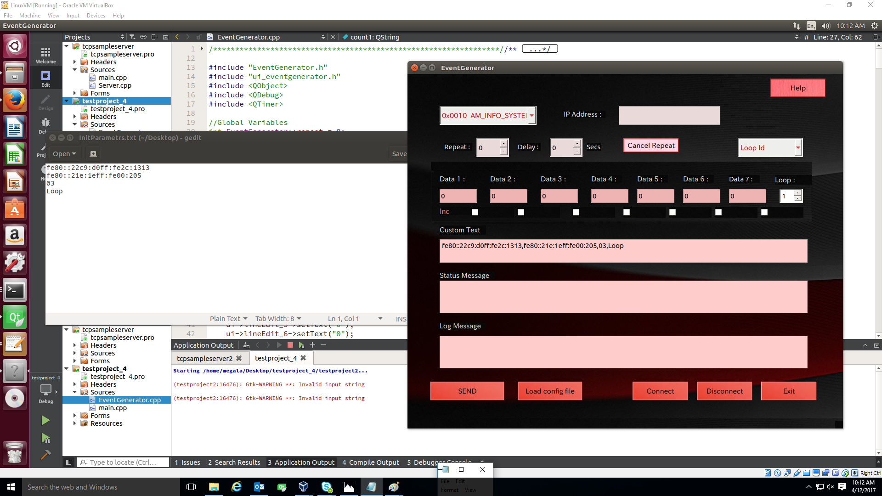

Slide 12
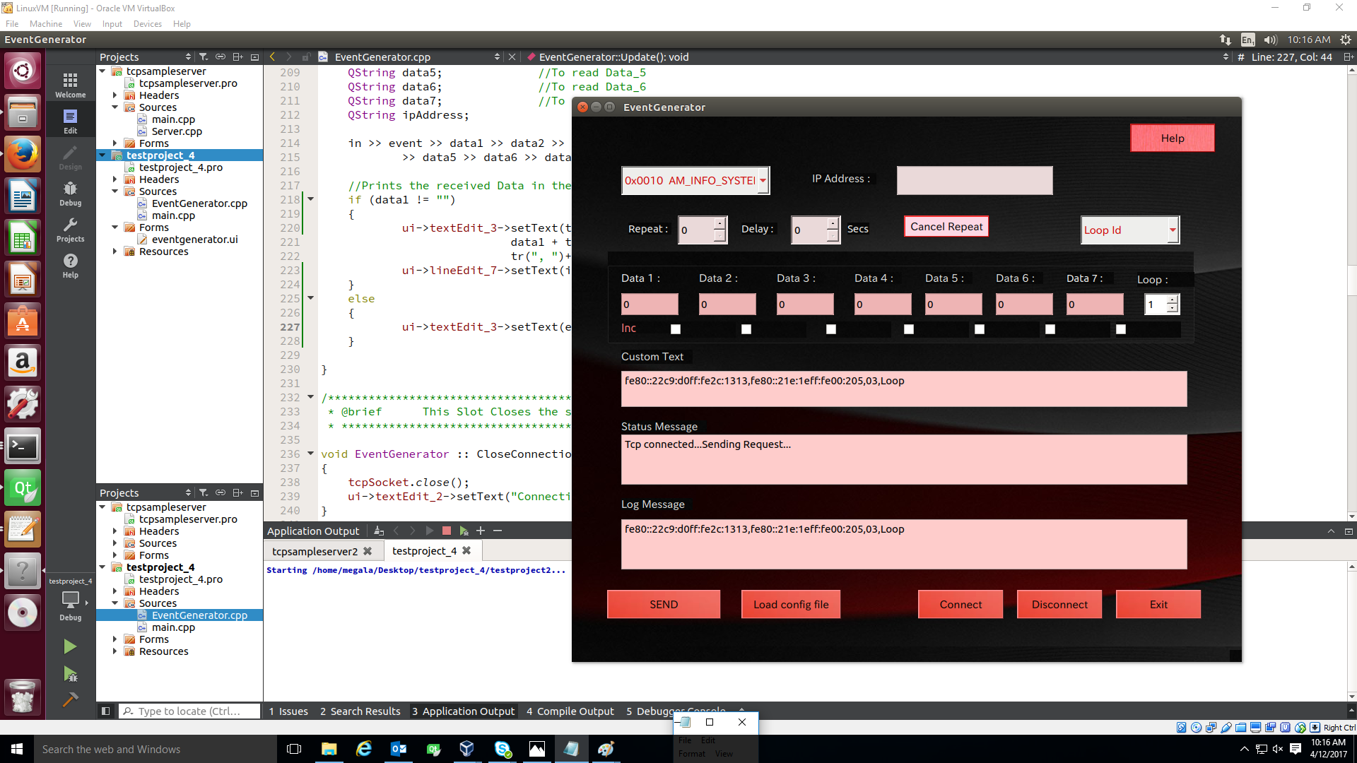

Slide 13
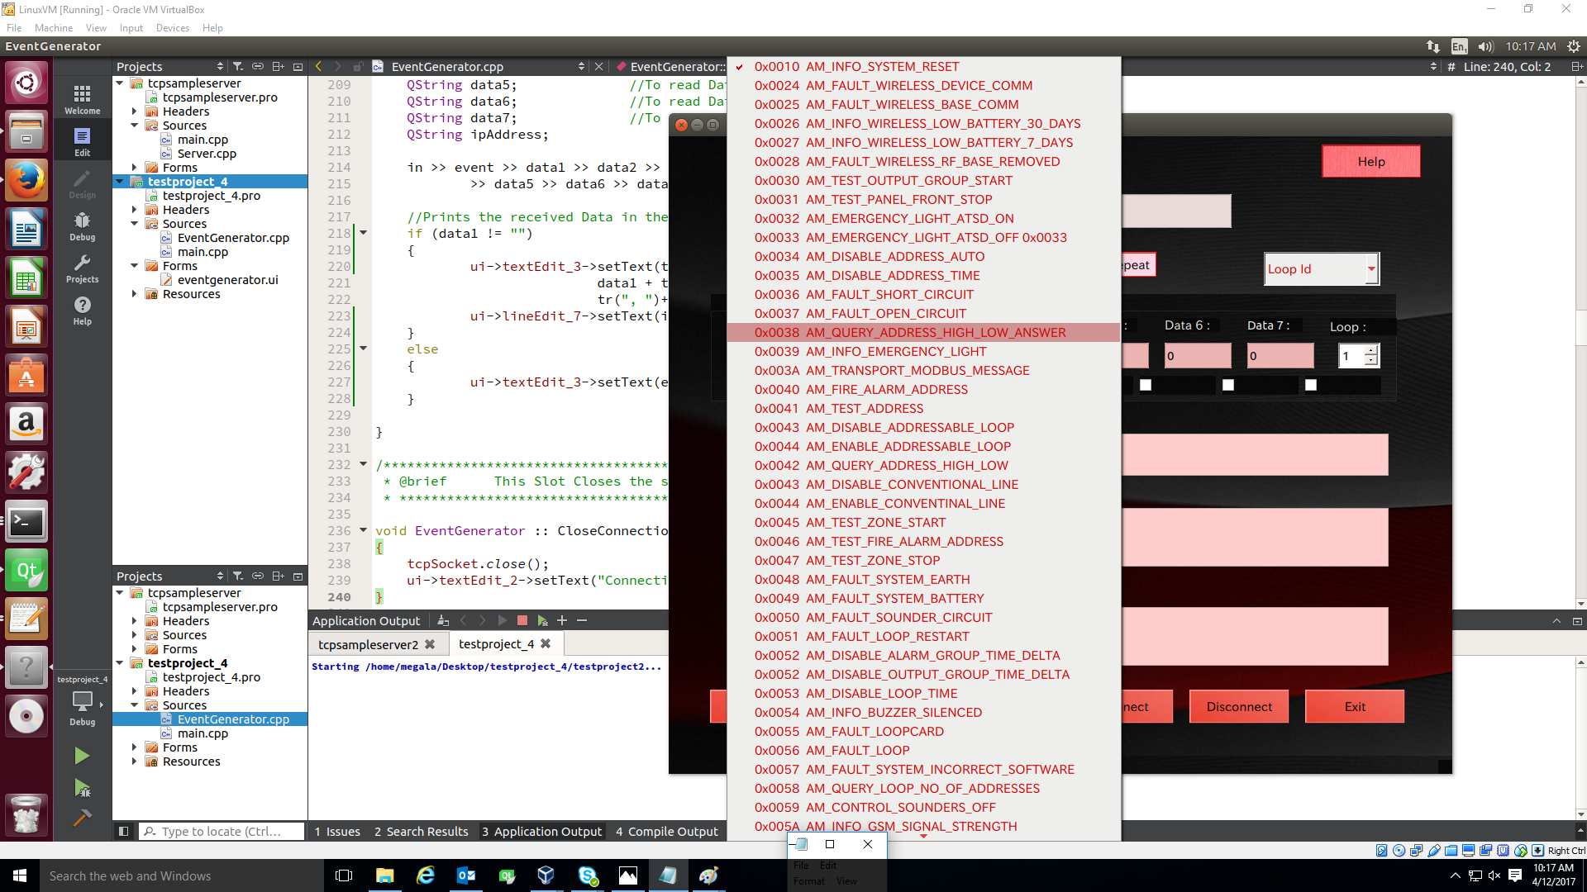

Slide 14


Slide 15
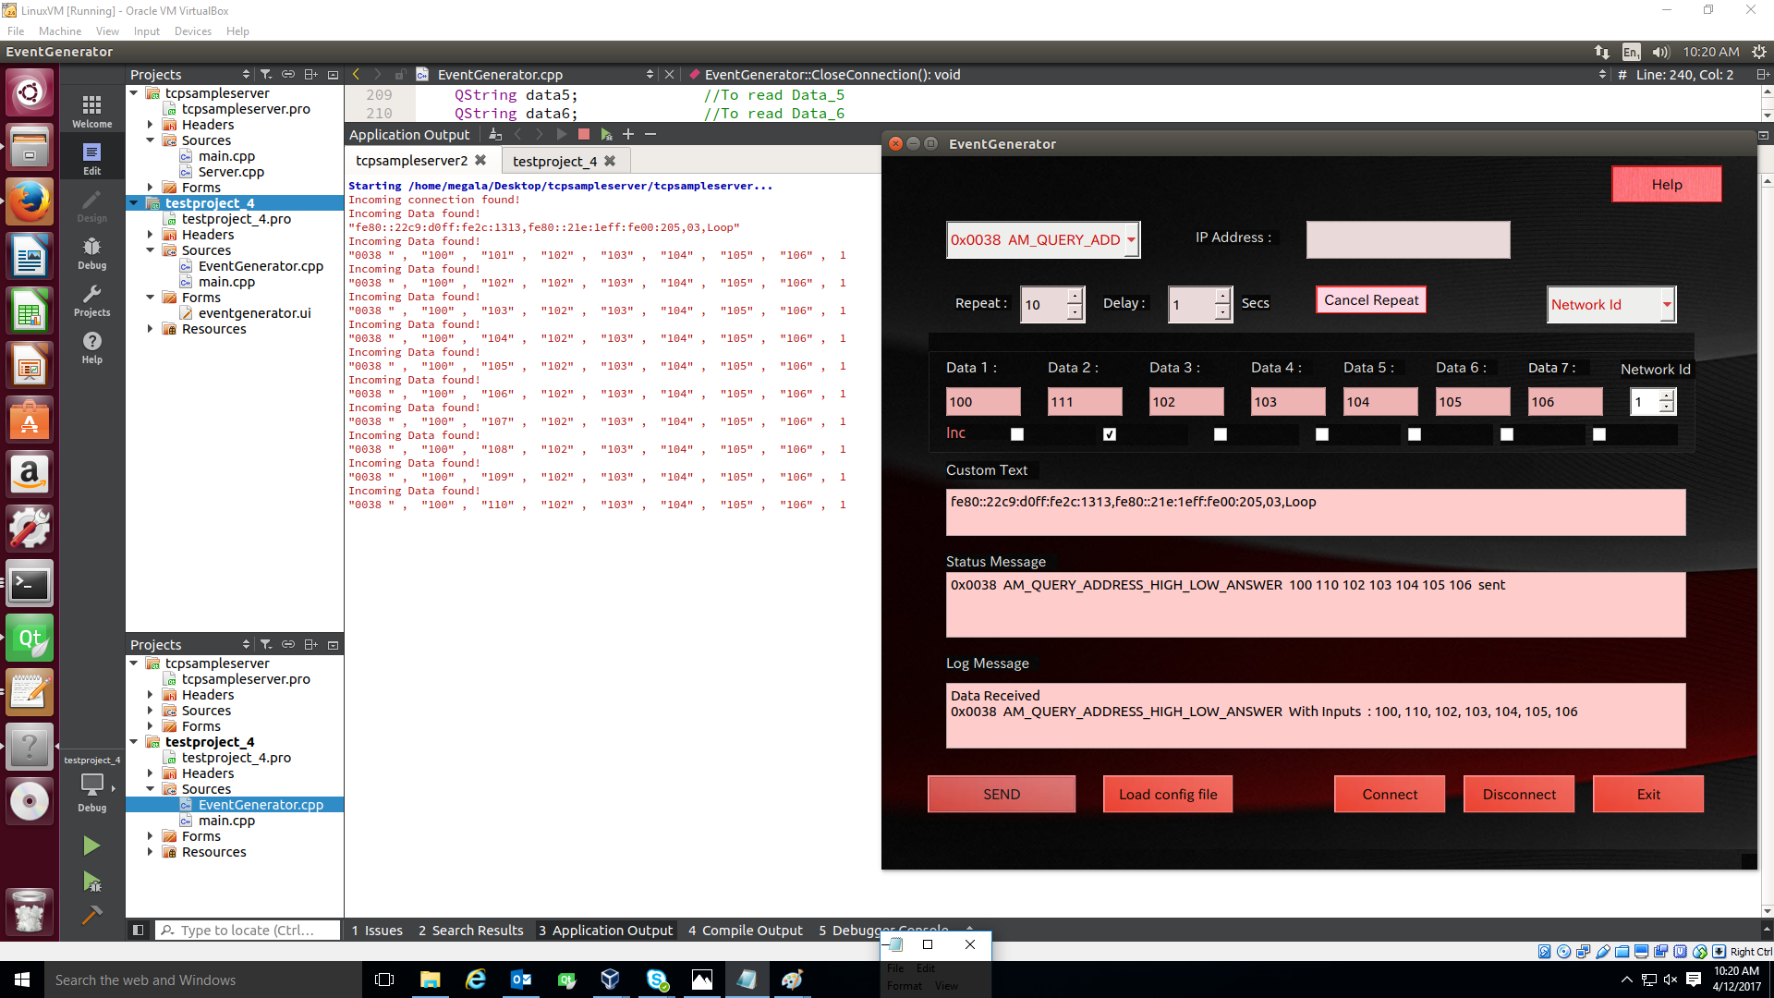

Slide 16
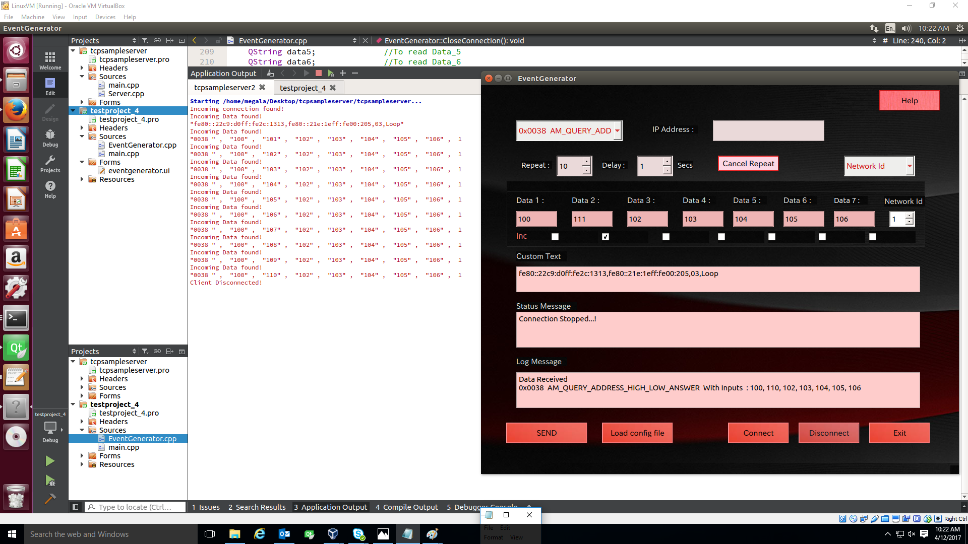

Slide 17
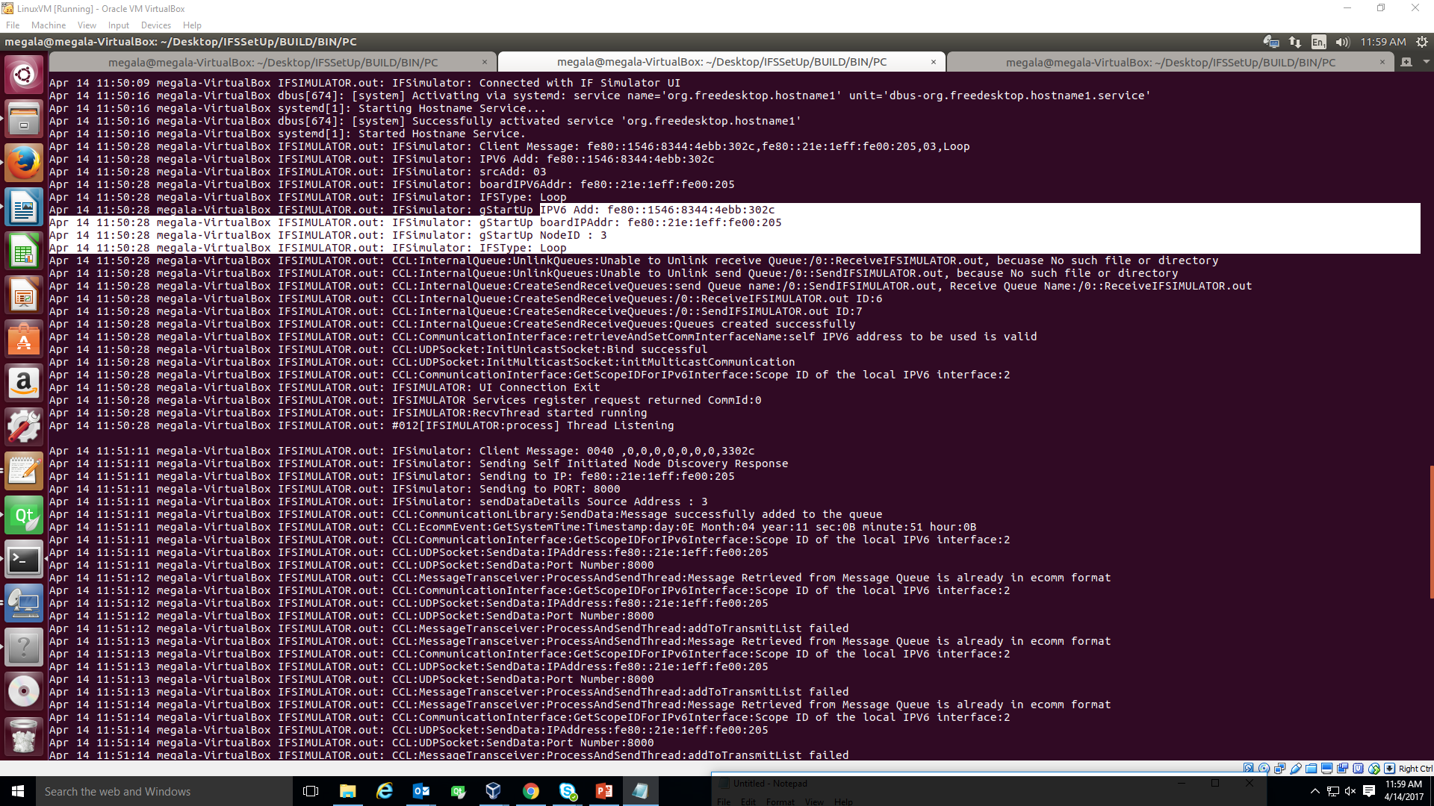

Slide 18
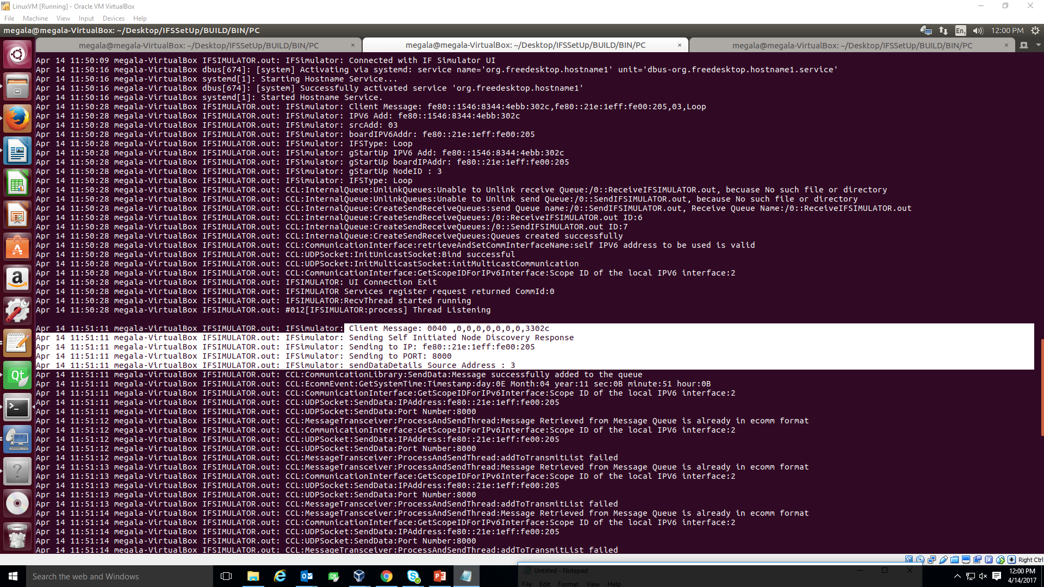

Slide 20
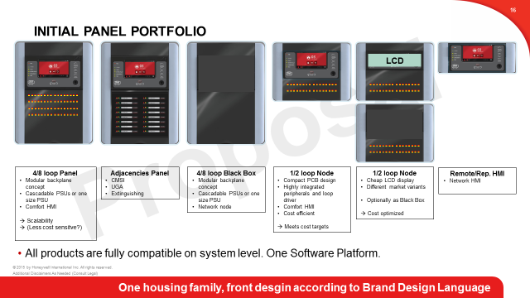
PANEL (Main CPU – with Module Design) Fire Panel comes up with different design in a Fusion project. The below diagram explains the different variants.

Slide 21
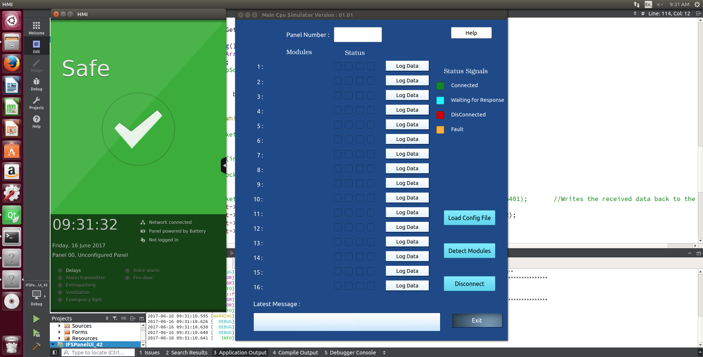

Slide 22
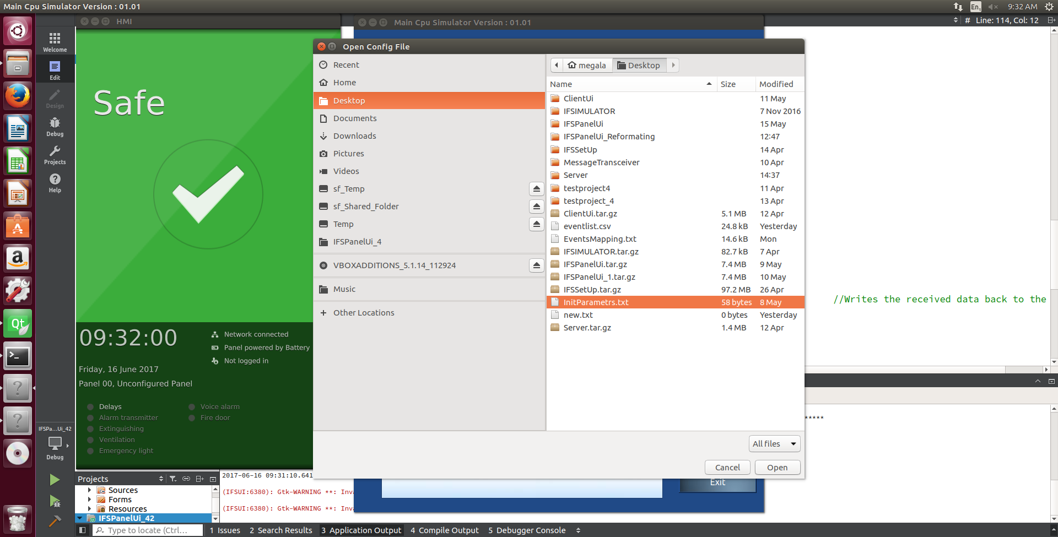

Slide 23
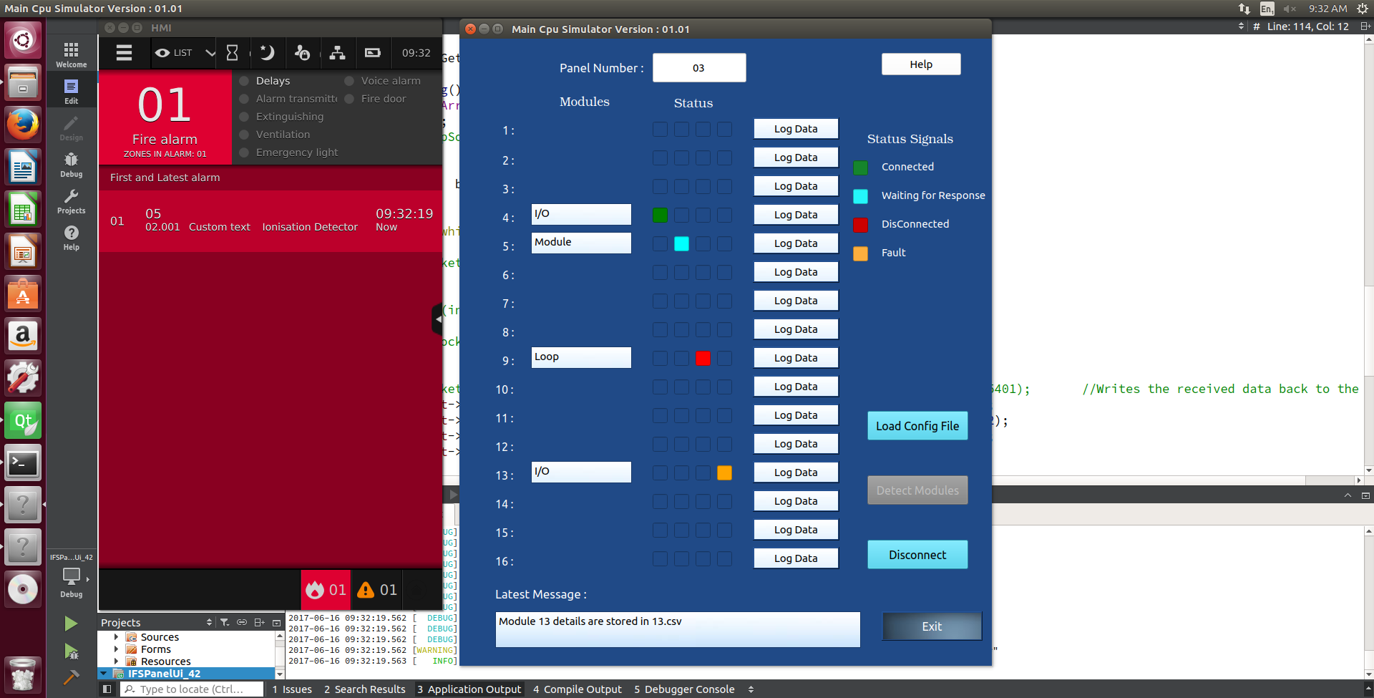

Slide 24
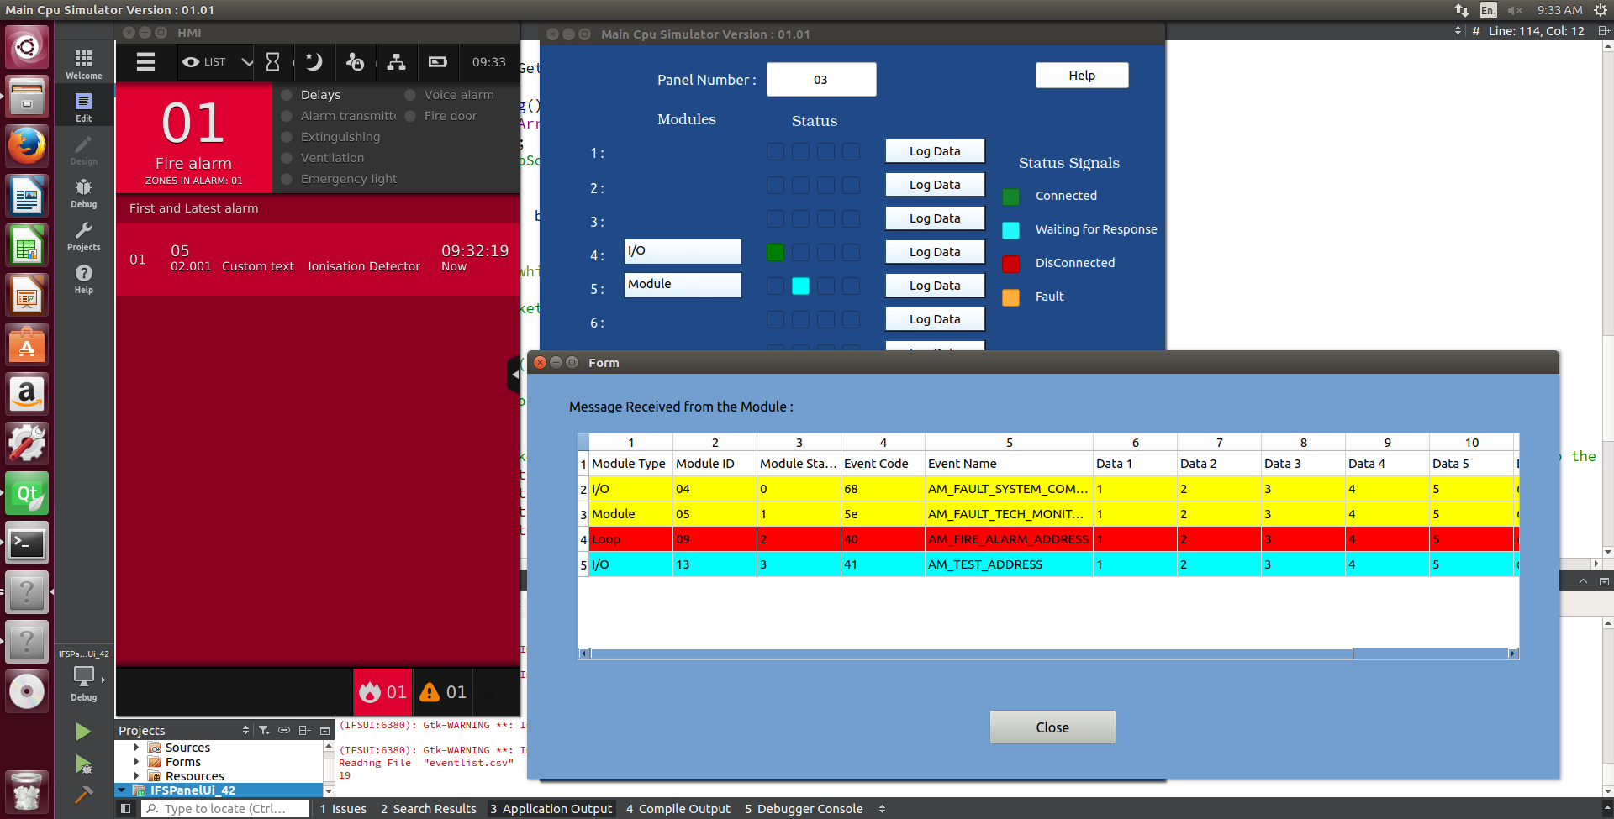

Slide 25
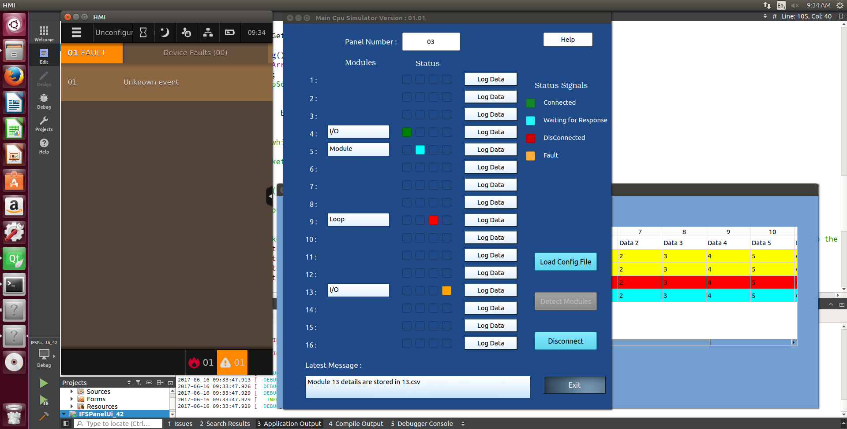

Slide 26
FUTURE WORK
Two more features need to be added with the Event Generator
To Enable browse and select configuration file/ event file option to run tests in the batch mode
To Provide a field to record each and every event’s log and other inputs, So that it can be used as a configuration file and also for future testing purpose

Slide 27
FUTURE WORK
Features need to be added with the Event Generator
Embed HMI with the Panel UI
Dynamically growing panel window

Slide 28
THANK YOU

